Slide 1

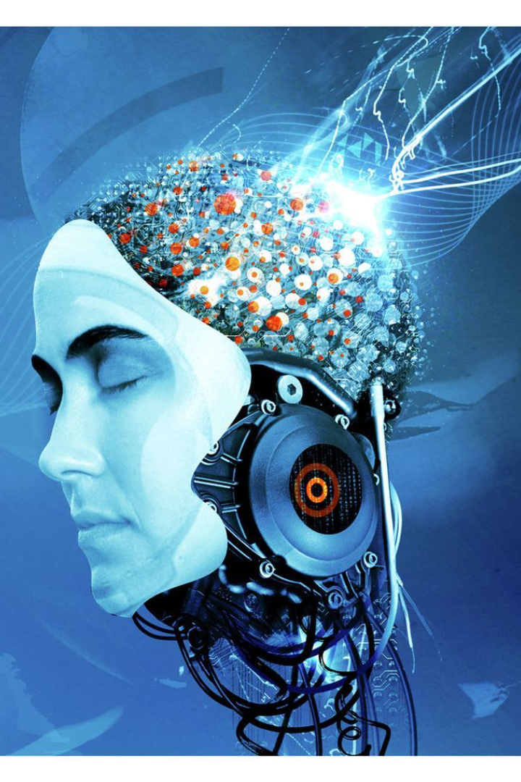
Generative Adversarial Networks
Group No- 14
Name: Pallab Sarkar
ID: 1801016
Name: Saurabh Joardar
ID: 1801028
pd
Name: Sieadatun Nahar Kanon
ID: 1901018
Name: Azmery Sara
ID: 1901006

Slide 2

Introduction to GANs
1
Definition
2
Applications
Generative Adversarial Networks are a type of AI model made up of two neural networks, working together to create new content or data.
GANs have been used for image and video generation, data augmentation, and even for creating deepfakes.
3
Components
The two key components of a GAN are the generator and the discriminator, which work together in a training process to improve the model's abilities.

Slide 3
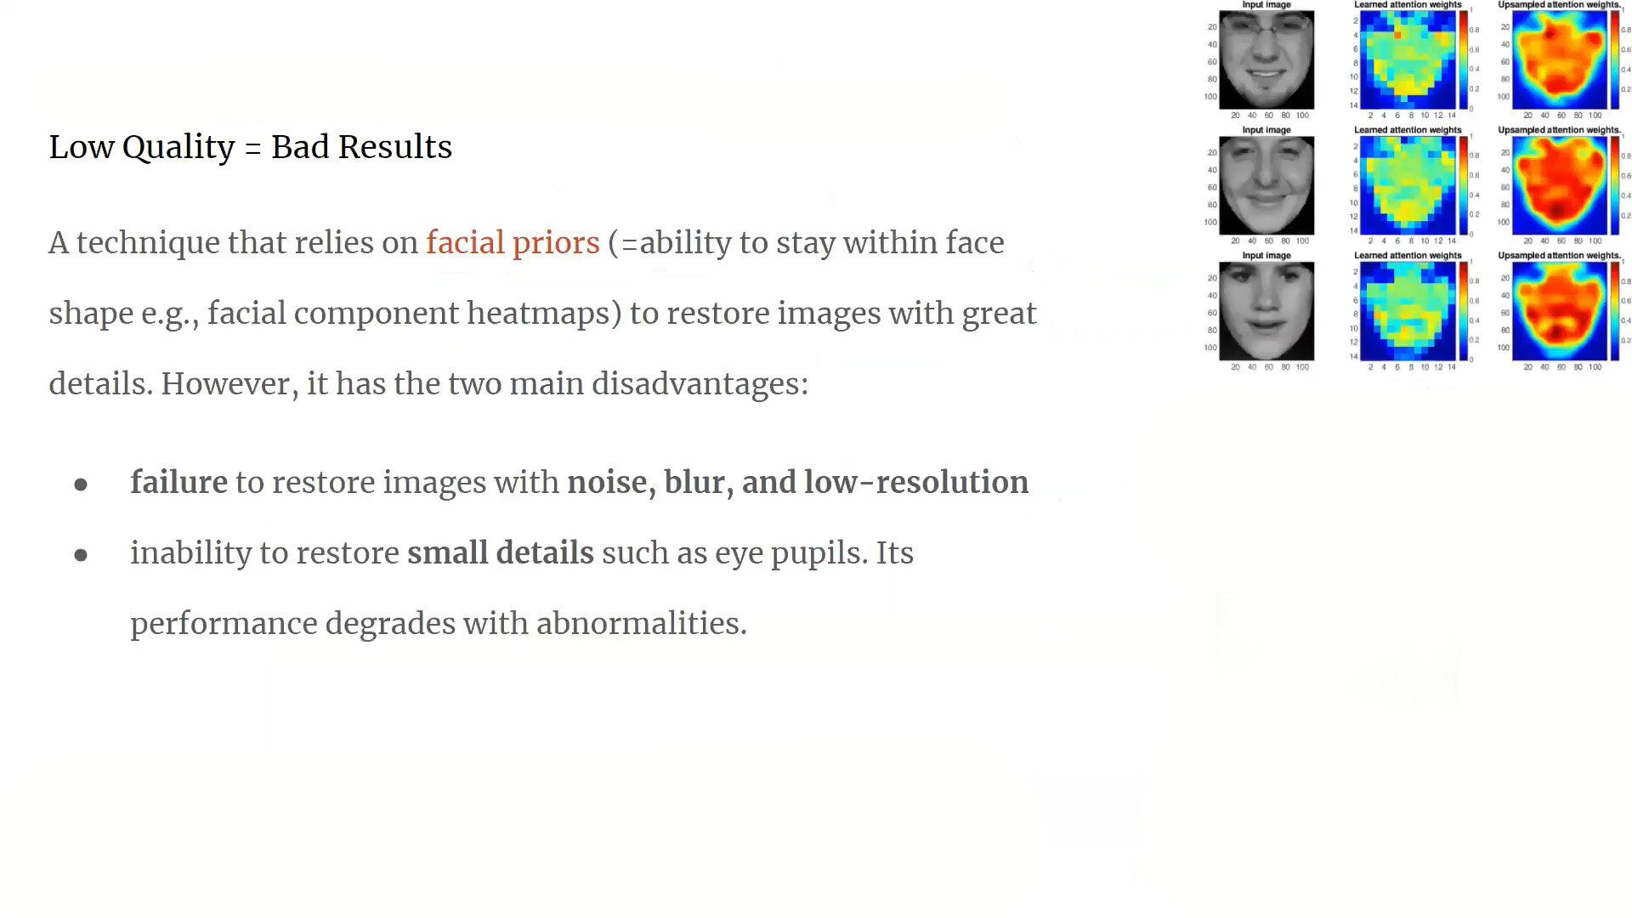

Slide 4
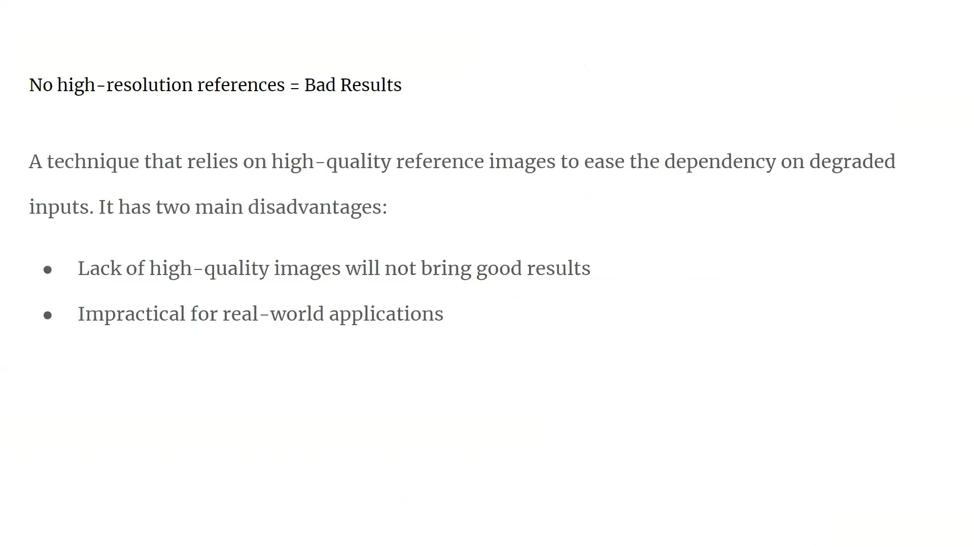

Slide 5
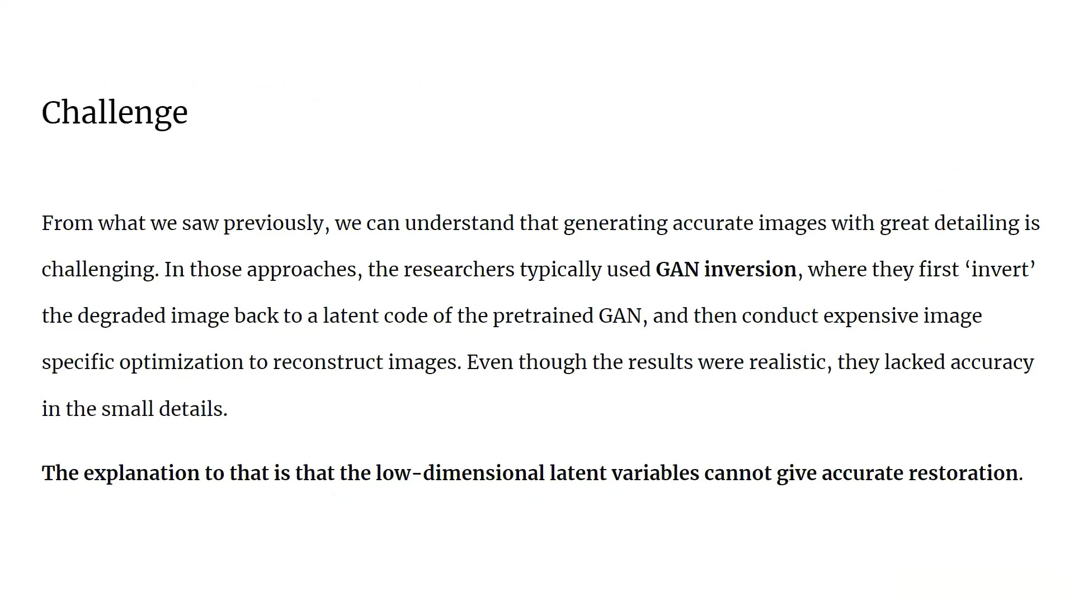

Slide 6
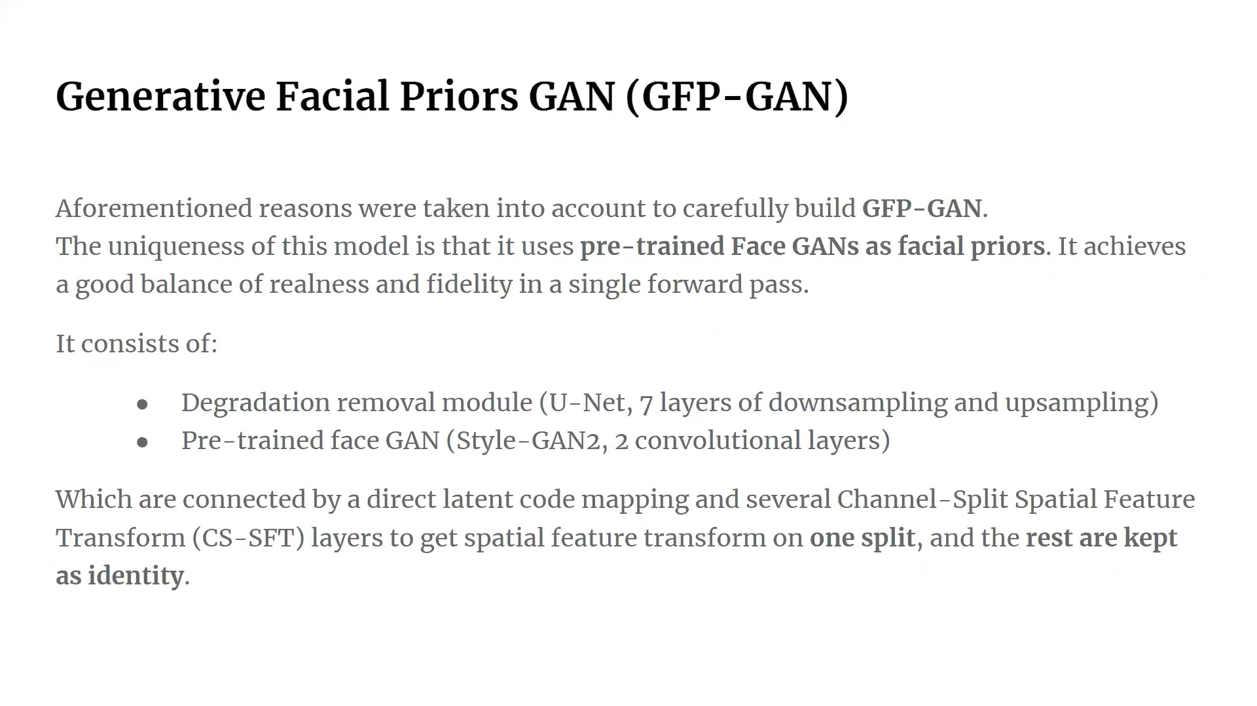

Slide 7
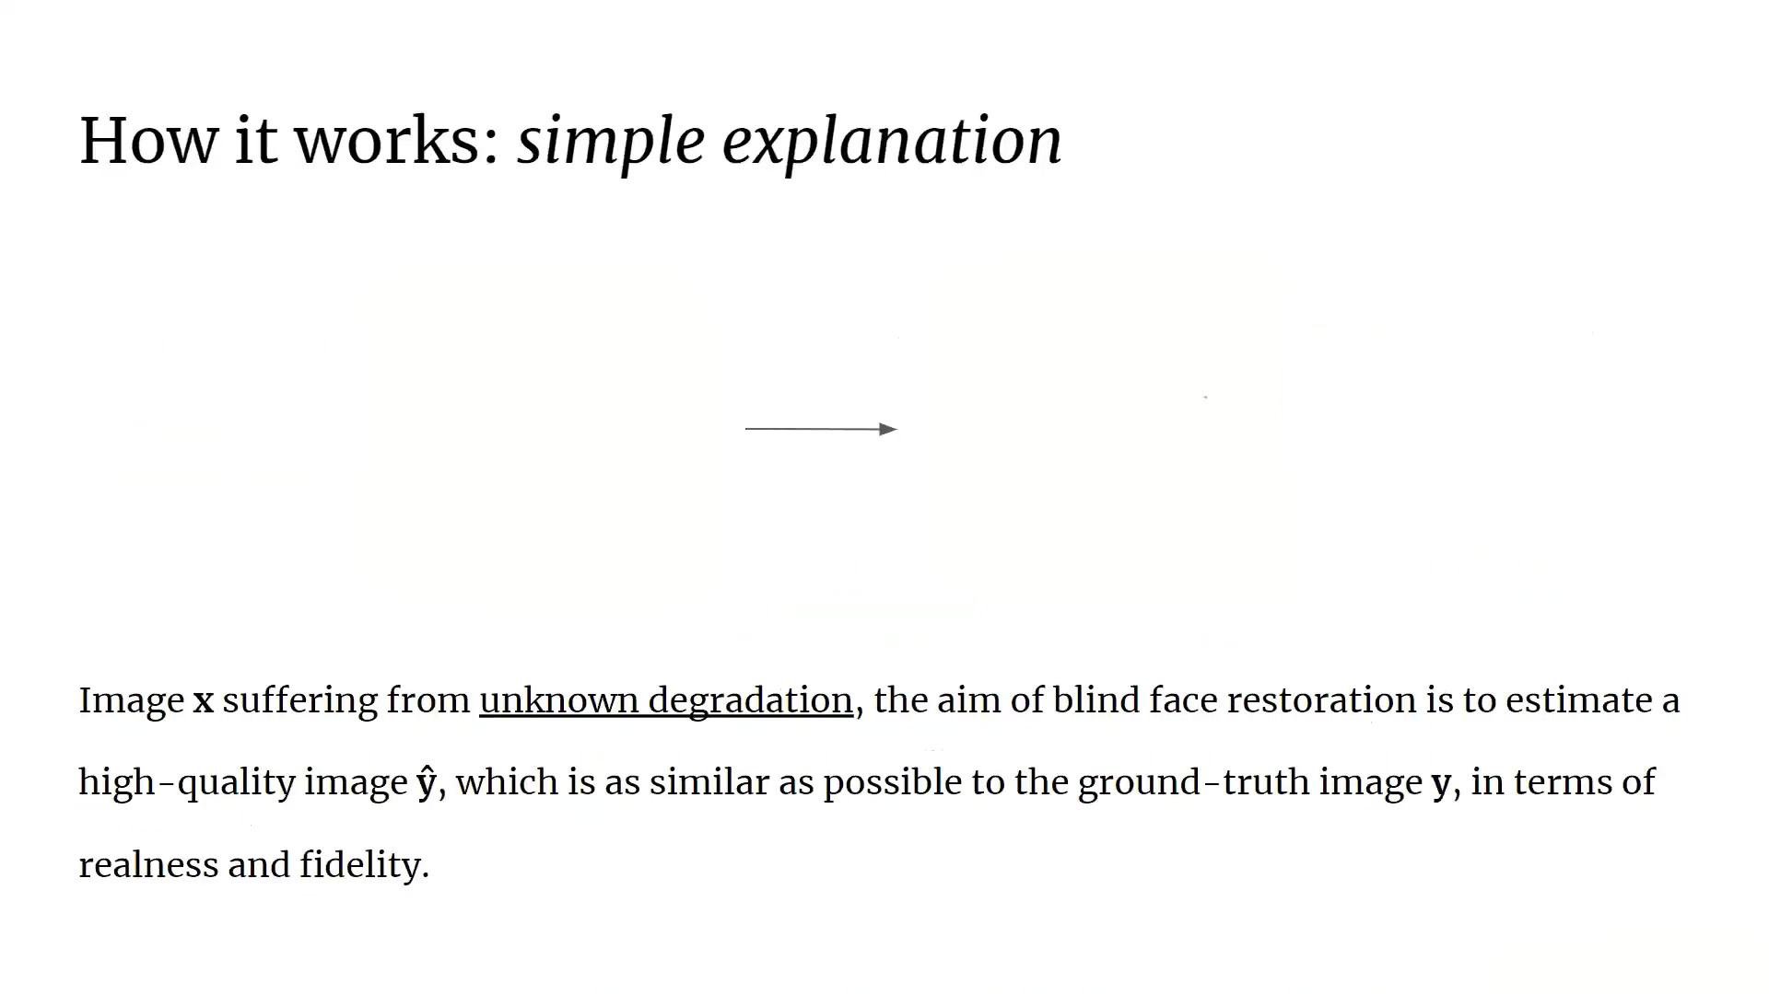

Slide 8
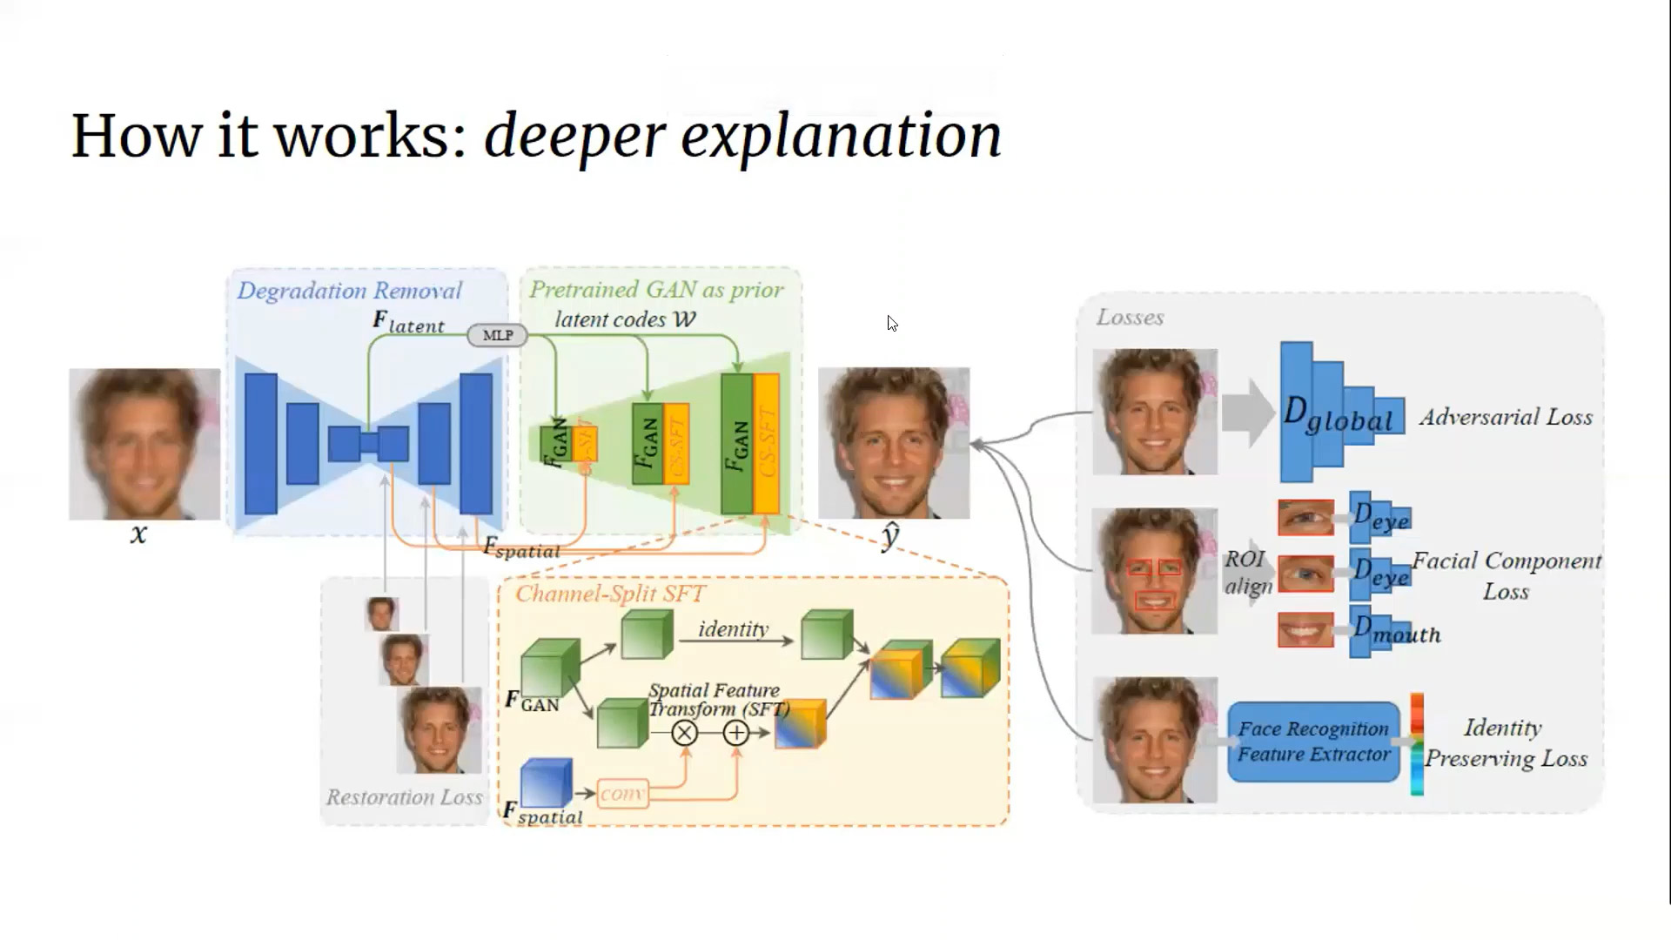

Slide 9
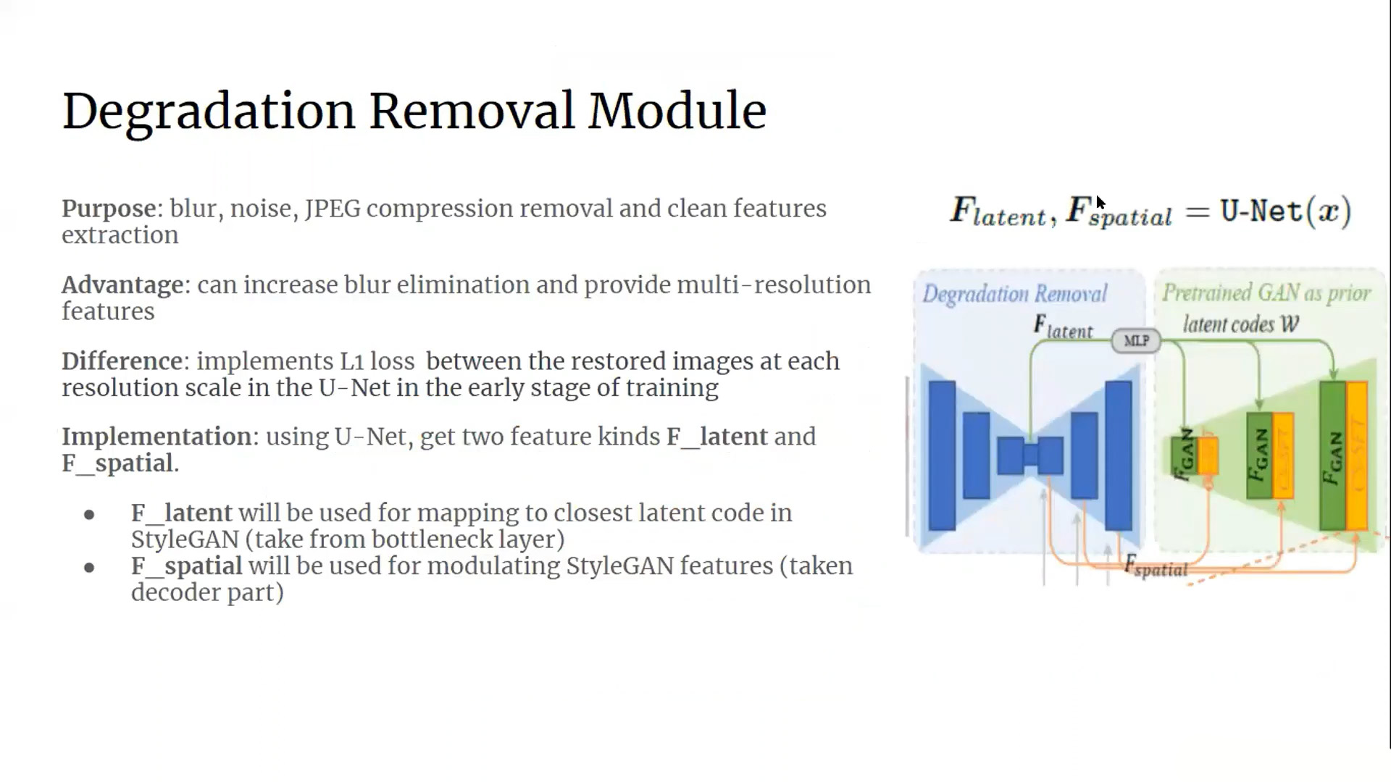

Slide 10
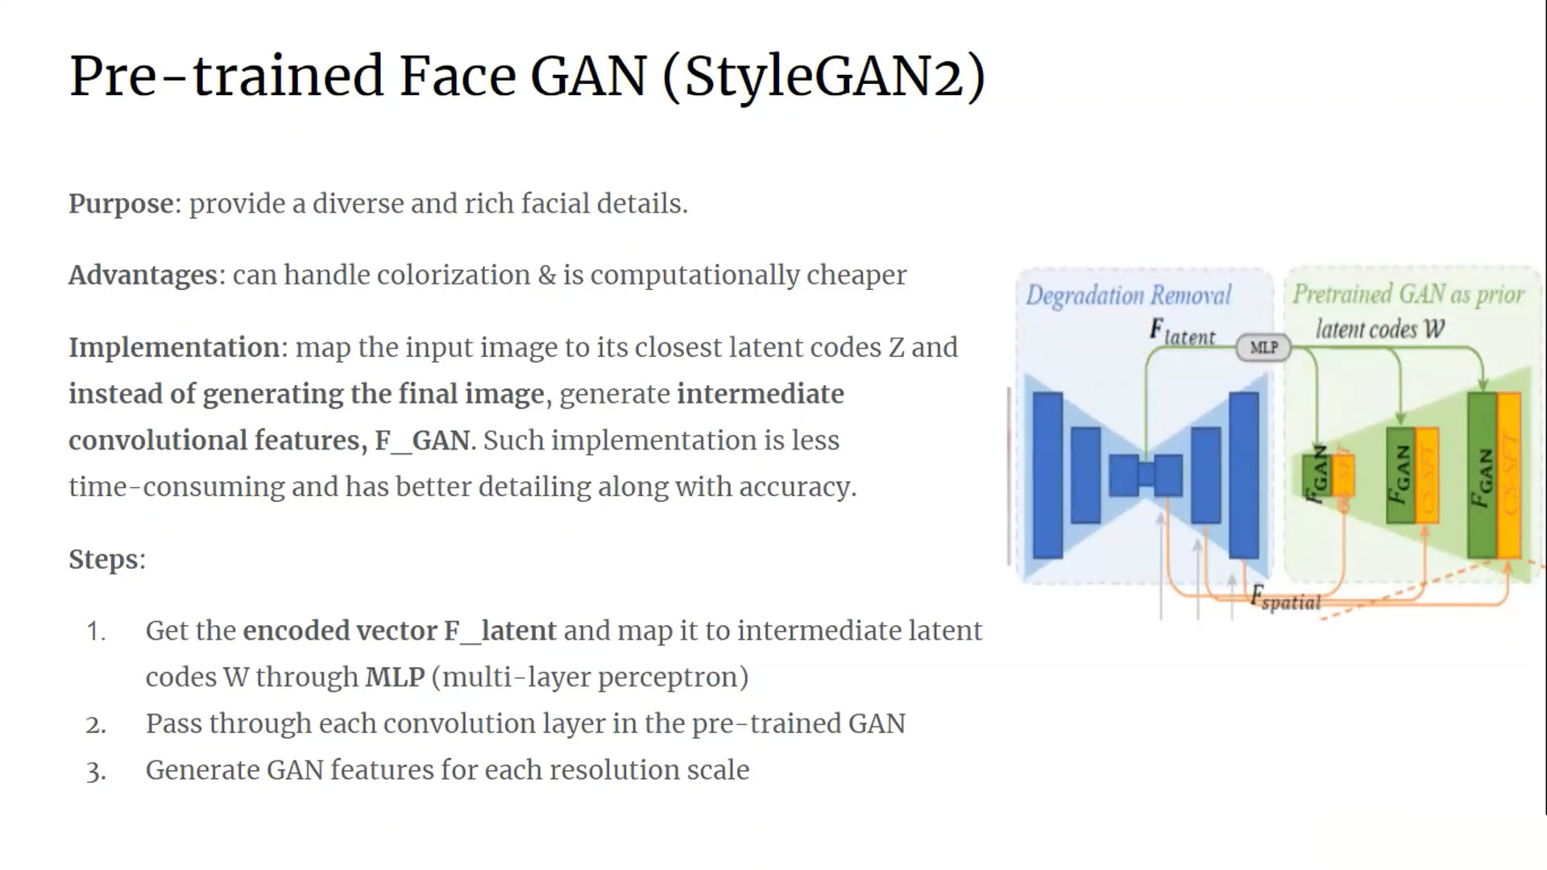

Slide 11
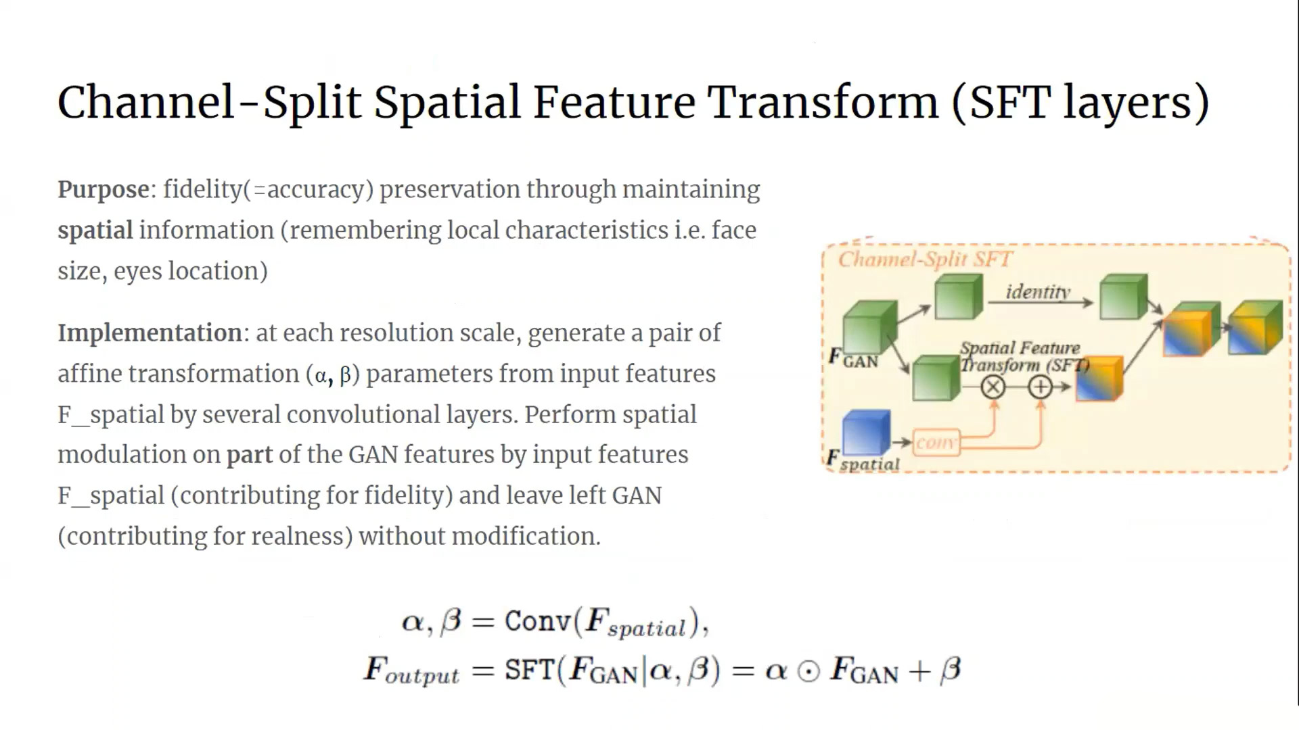

Slide 12
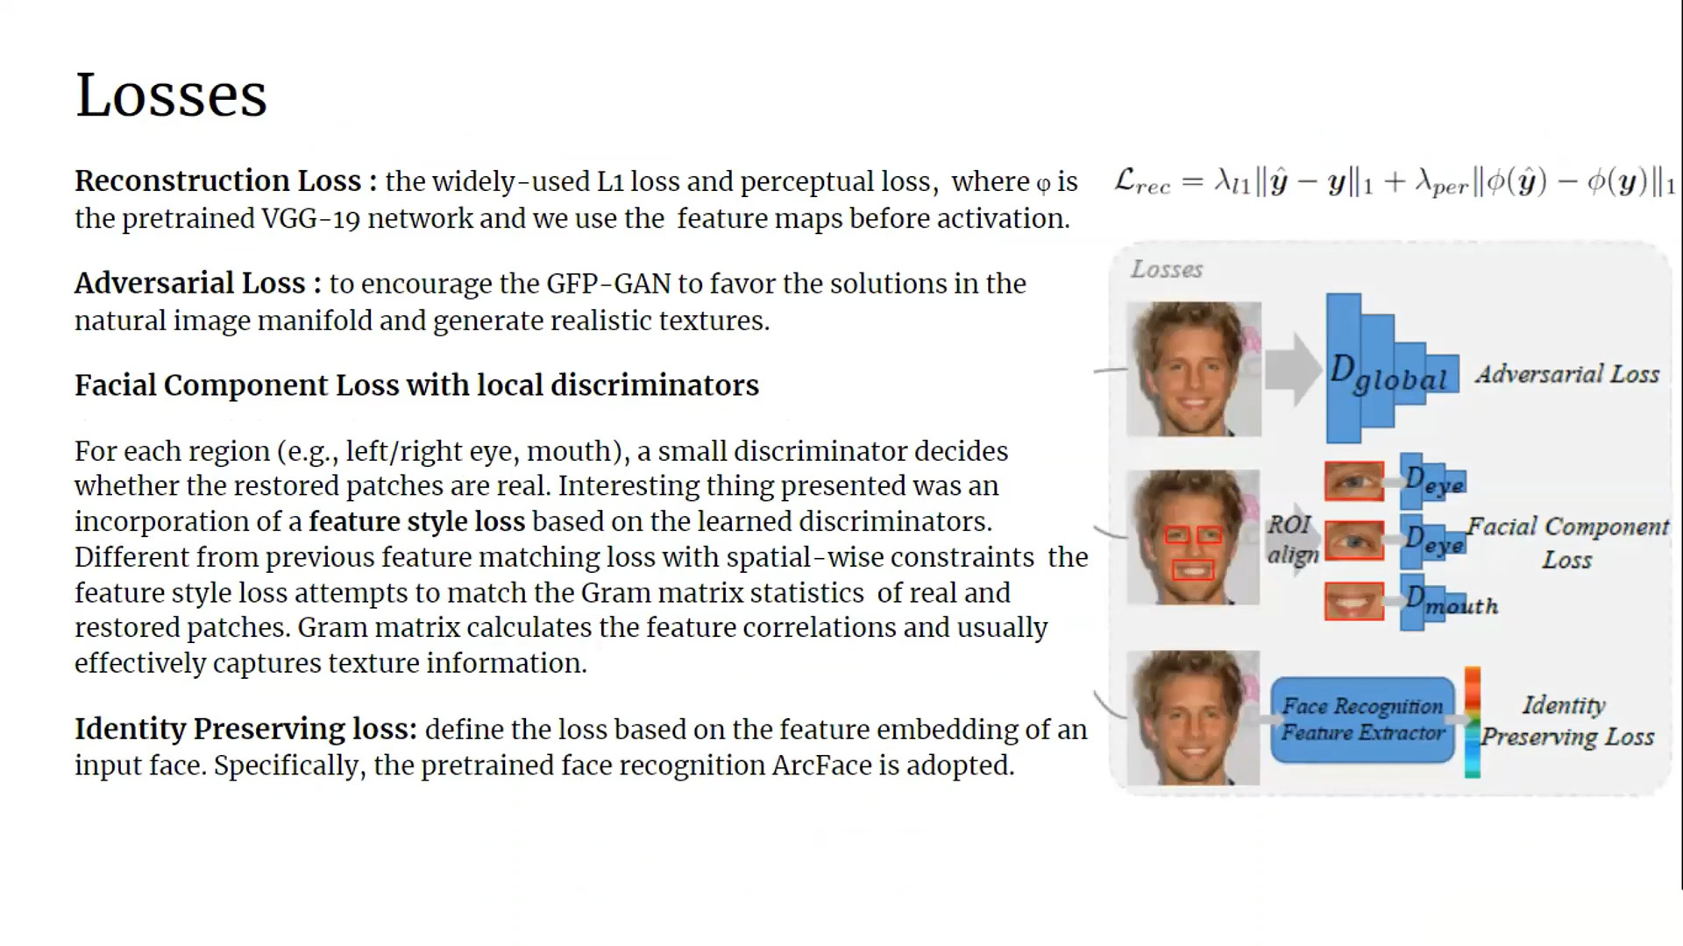

Slide 13
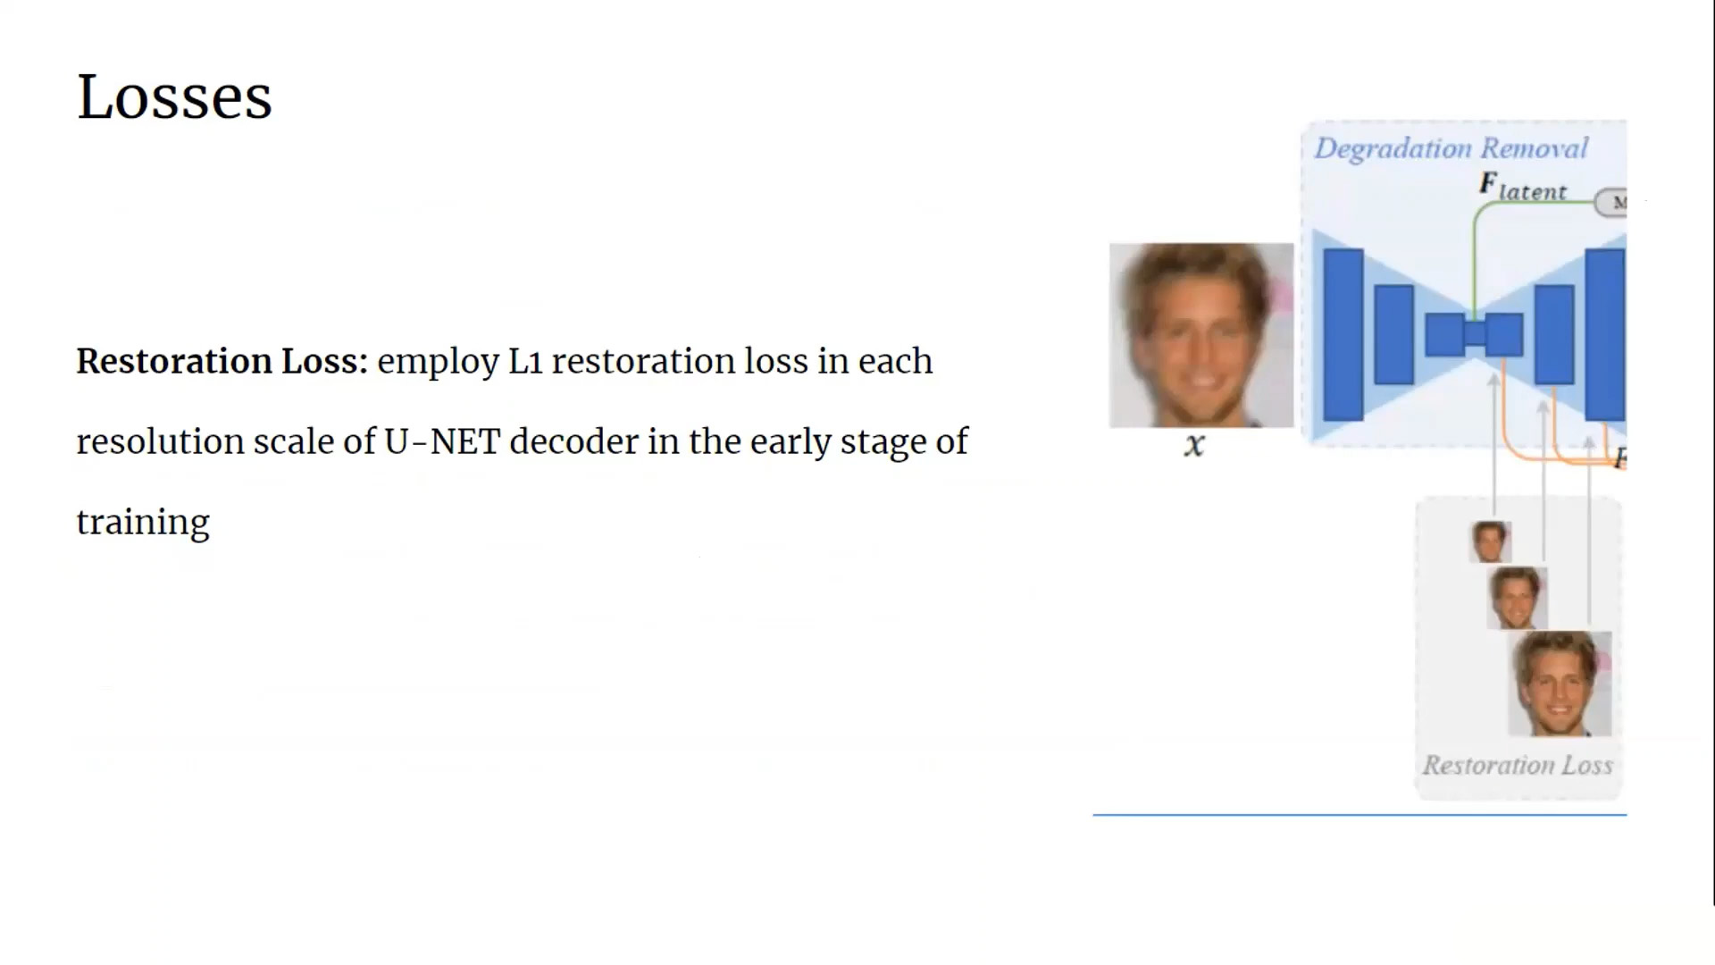

Slide 14
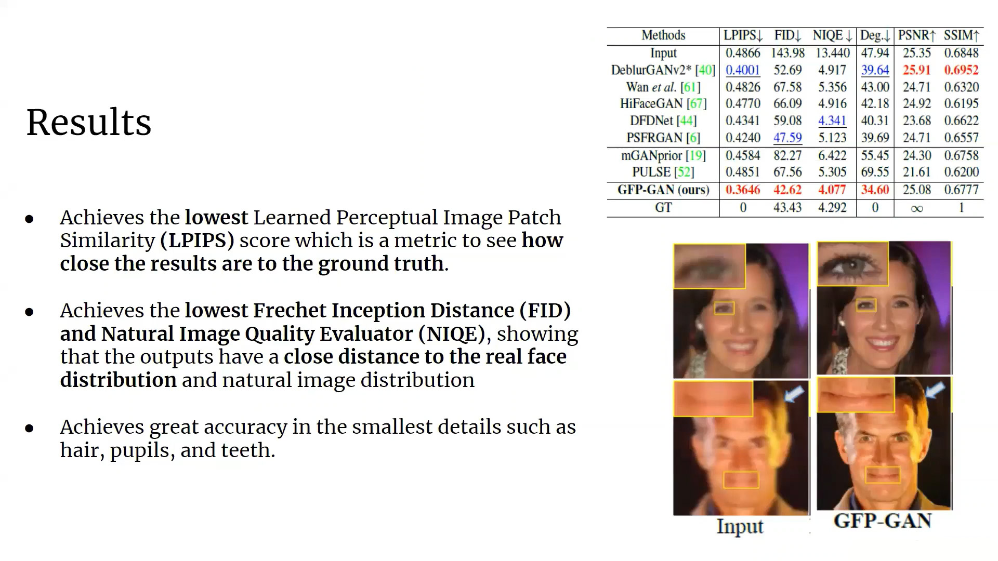

Slide 15
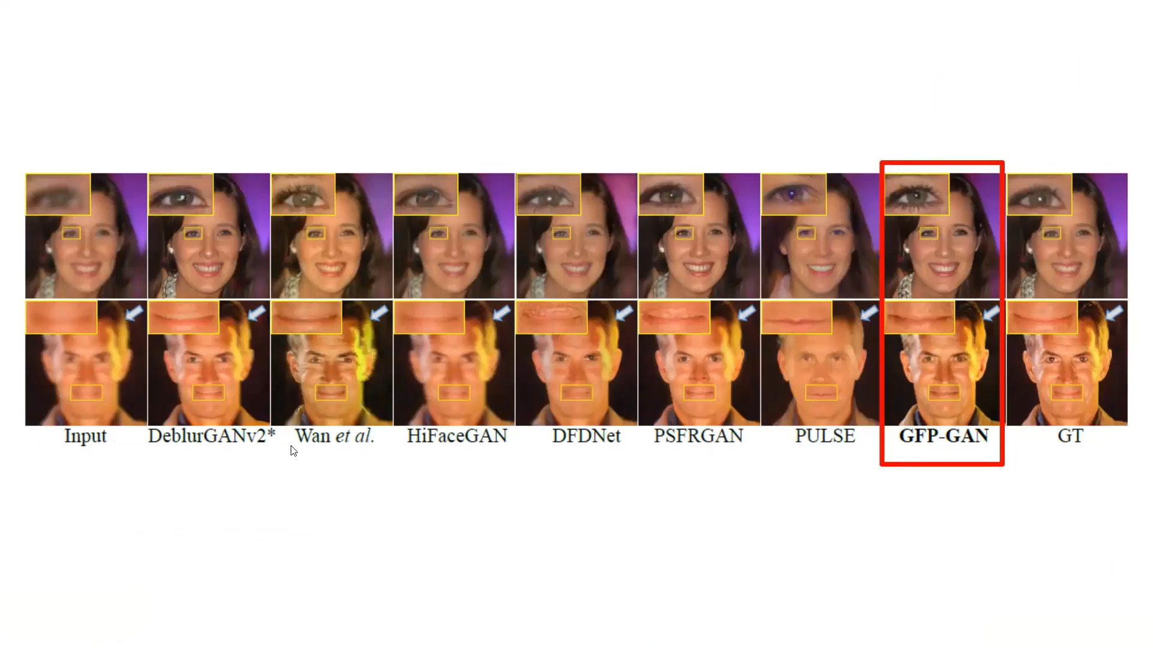

Slide 16
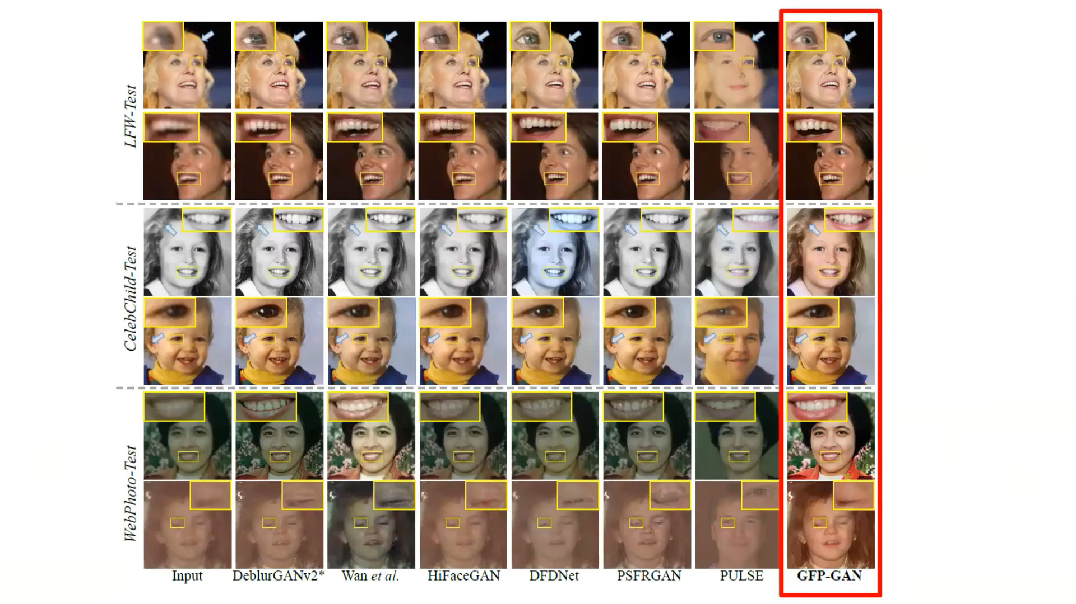

Slide 17
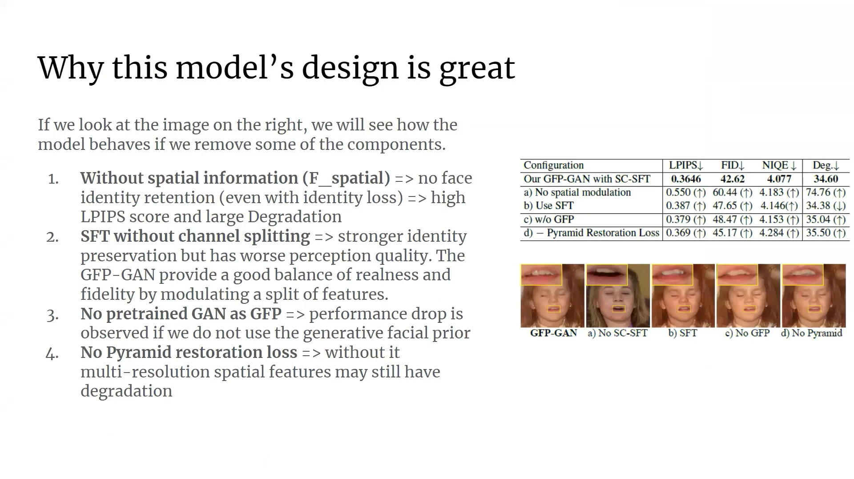

Slide 18
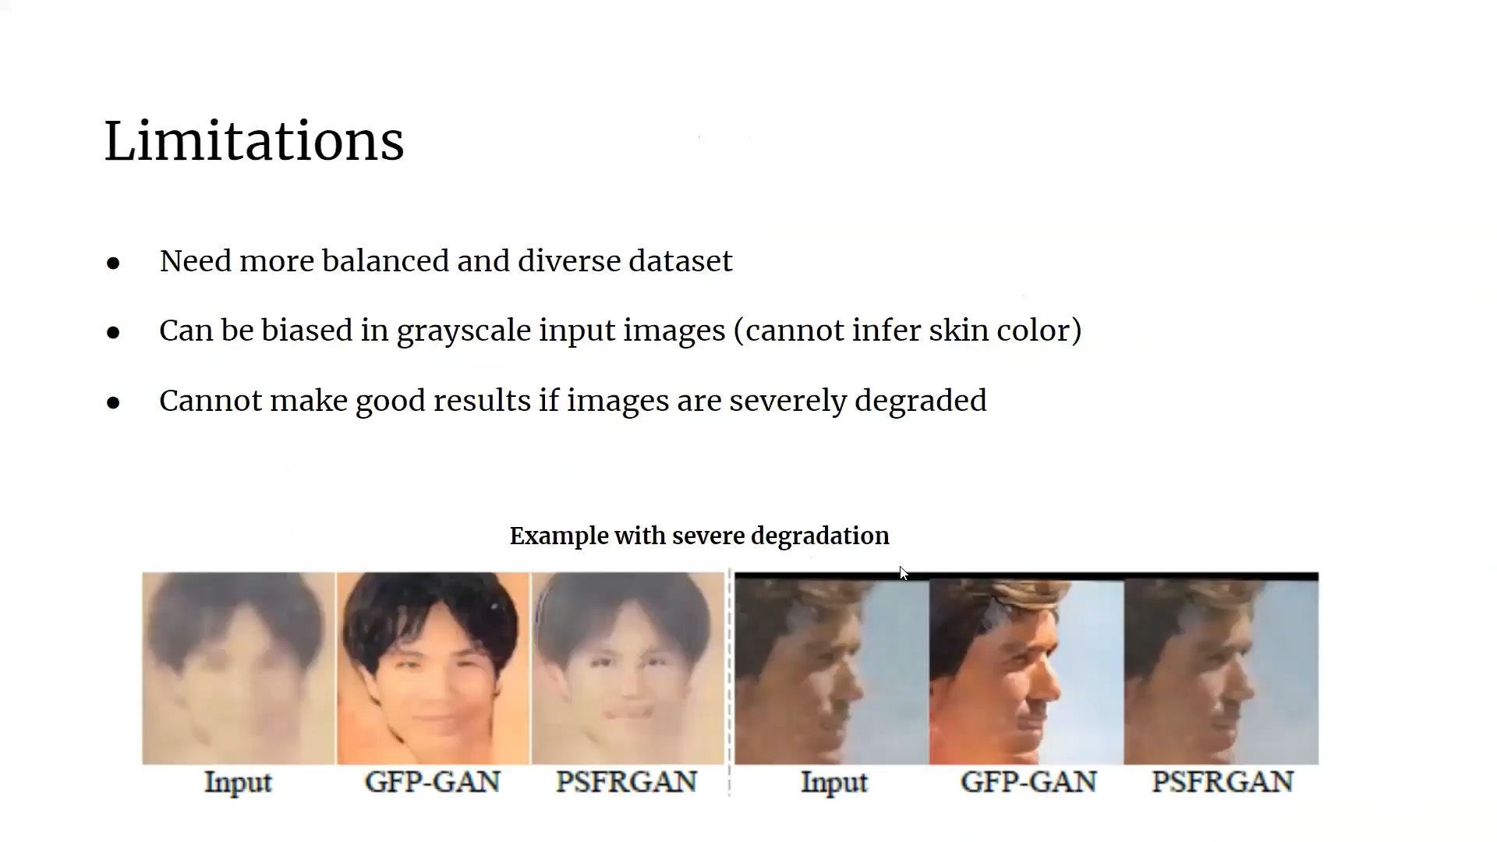


Slide 19
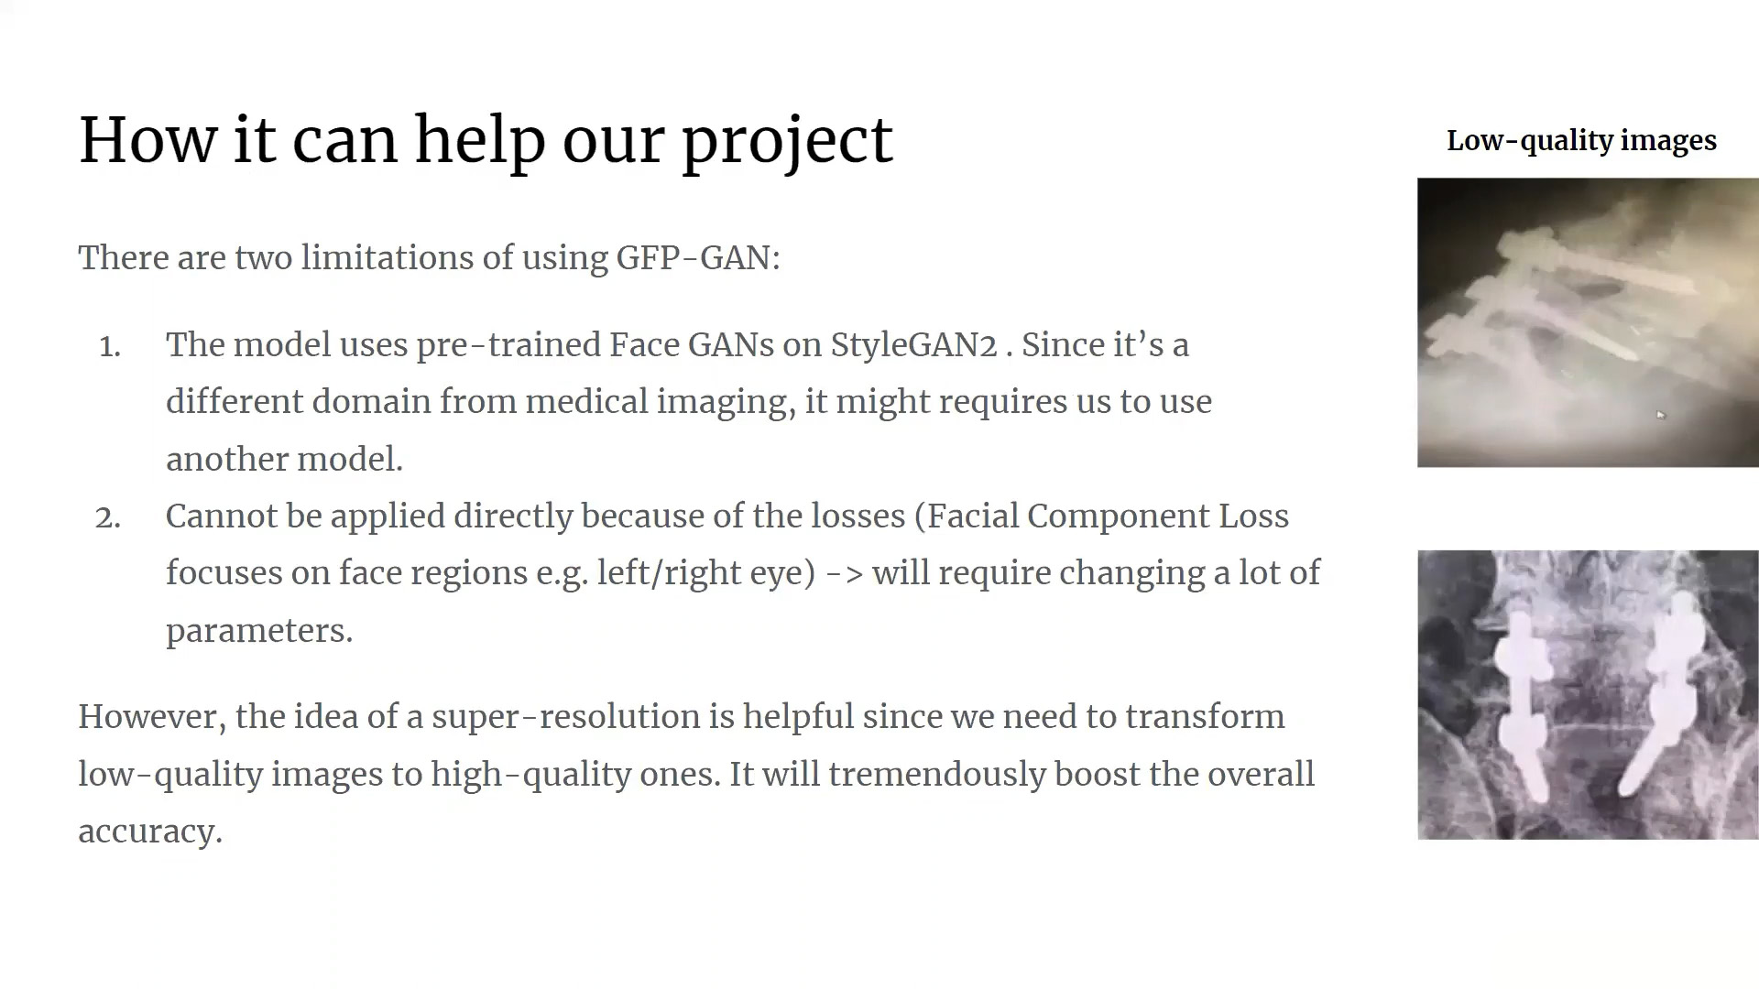




Slide 20
Thank You

